Slide 1

Healthcare Fraud Detection System
Distributed & Scalable Data Engineering (DSCI 6007)
University of New Haven | Instructor: Dr. Sula Ardiana
Team 9: Karthik Kandimalla & Manis Chaudhary

Slide 2


Meet the Team
Karthik Kandimalla
Manis Chaudhary
Data Engineer & Architect
Data Scientist & Pipeline Developer
Both team members collaborated extensively on the crucial phases of the project, including data ingestion strategy, designing the complex ETL process, and training the machine learning models for fraud detection.

Slide 3

The Financial Impact of Healthcare Fraud
Scale of the Problem
Healthcare fraud costs the U.S. healthcare system over $80 billion annually—a staggering loss that impacts premiums and resources.
The Current Challenge
Fraudulent providers systematically submit false claims for services that were never rendered or necessary.
Why Automation is Needed
Traditional manual audits are inherently slow, expensive, and inconsistent, making large-scale detection nearly impossible.
Our project addresses this by developing an automated, data-driven pipeline to identify and flag suspicious billing patterns proactively.

Slide 4
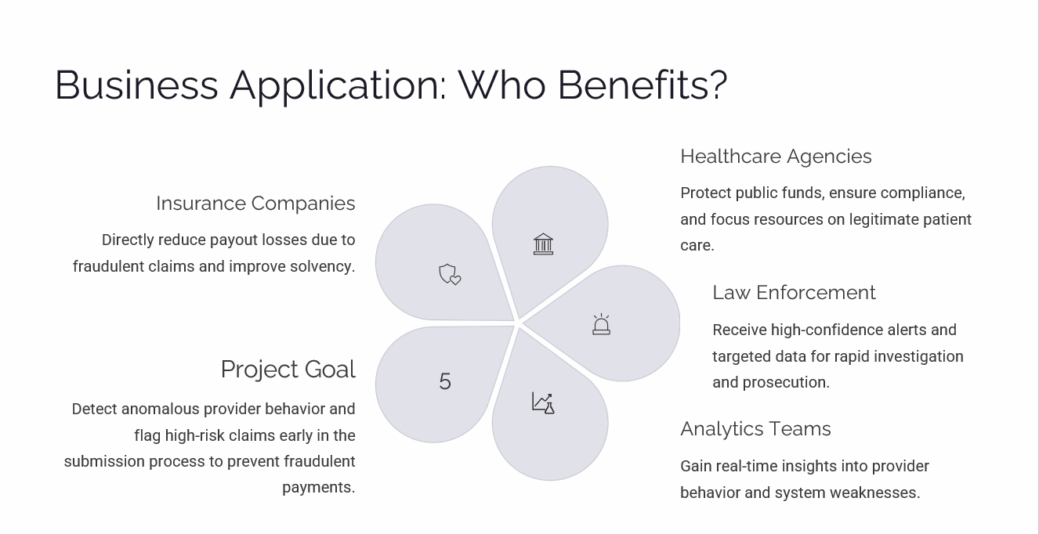

Slide 5





Project Objectives and Deliverables
End-to-End Data Pipeline
Build a robust and scalable data pipeline capable of processing high-volume claims data continuously.
Data Integration
Successfully integrate and harmonize diverse datasets, including inpatient claims, outpatient claims, provider registries, and beneficiary demographic information.
ML Model Application
Apply and tune advanced machine learning algorithms (e.g., Random Forest) to classify providers as either fraudulent or not fraudulent.
Interactive Monitoring
Deliver interactive dashboards for operations teams, enabling easy visualization and monitoring of fraud risks and decision-making.

Slide 6



Dataset and Feature Engineering
We utilized a comprehensive dataset to build our detection system:
Key Features Used for Modeling:
Dataset Snapshot
Source: Kaggle – Medicare Provider Fraud Detection Dataset
Claim Attributes: Provider ID, total claim amounts, and specific admission/discharge dates.
Clinical Information: Detailed patient demographics, diagnosis codes, and complex procedure codes.
Size: Approximately 1.4 million individual claims spanning 2022–2023.
Behavioral Patterns: Extracted geographic, temporal (e.g., weekend claims), and referral patterns to identify anomalies.

Slide 7





Data Engineering & Analysis Pipeline Flow
The pipeline translates raw claims data into actionable intelligence for fraud detection.
1. Data Ingestion
Load raw claims data (CSV) directly into a scalable storage solution like AWS S3.
2. ETL Processing
Perform data cleaning, feature extraction, and transformations using PySpark and Pandas for massive scale.
3. Data Storage
Persist processed and structured data in optimized databases like AWS Redshift or PostgreSQL.
4. ML Training
Train predictive models (Random Forest, SVM) on labeled data to classify fraud.
5. Visualization
Present results, alerts, and provider risks using interactive business intelligence tools (Power BI).

Slide 8





System Architecture Layers
A layered architecture ensures scalability, modularity, and maintainability for the fraud detection system.
Visualization Layer
Interactive dashboards (Power BI) for monitoring fraud alerts and provider risk scores.
Analytics Layer
ML Model Training & Evaluation, providing the core fraud prediction capabilities.
Data Storage Layer
Optimized databases (AWS Redshift / PostgreSQL) for fast access and complex querying.
ETL Layer
Python and Apache Spark transformations for data processing and cleansing.
Data Source Layer
Raw healthcare datasets (Inpatient and Outpatient Claims).

Slide 9
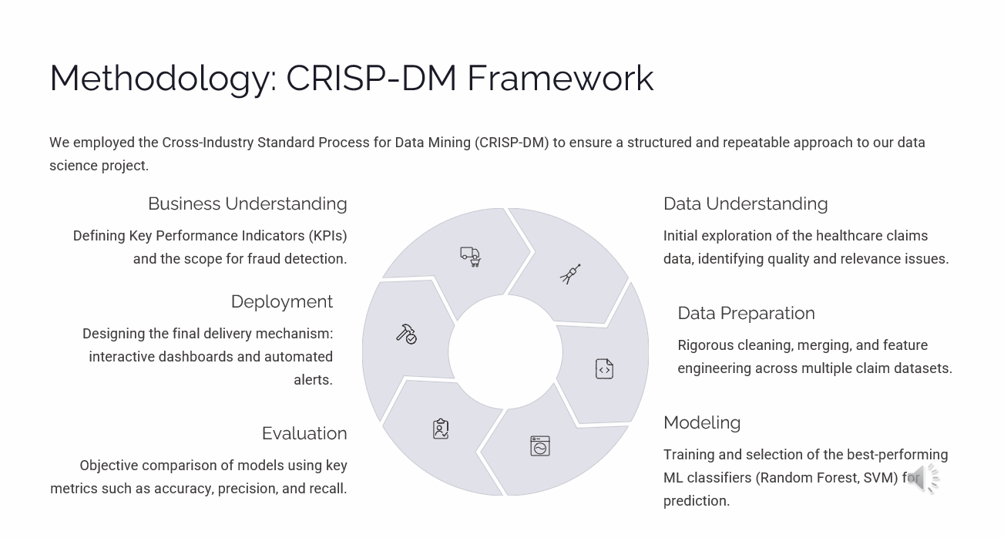

Slide 10

Key Results and Fraud Detection Insights
94%
Top 50
2X
Model Accuracy
High-Risk Providers
Anomalies Detected
Random Forest demonstrated a high level of accuracy and effective balance between precision and recall for detecting fraud.
The system successfully identified the top providers exhibiting statistically significant fraudulent claim patterns.
We specifically detected sophisticated anomalies such as duplicate billing and strategic upcoding of procedure codes.
Actionable Intelligence
The dashboards provide operations teams with provider-level fraud probability scores.
These insights allow for targeted and efficient allocation of audit resources.
The system offers a scalable foundation for continuous monitoring and adaptive defense against new fraud schemes.

Slide 11
Thank You
Team 9: Karthik Kandimalla & Manis Chaudhary
Distributed & Scalable Data Engineering (DSCI 6007)
University of New Haven

Slide 12
GitHub Link: https://github.com/manischaudhary/Healthcare-Fraud-Detection-System-
Presentation video folder link: https://drive.google.com/drive/folders/1xiVX1Mr4XDepz5Y5ysBhX981aynX7GBs

